Slide 1
Basic computational number theory
(ft. Jacques Amsel – a number theorist renowned by nobody)

Slide 2
Primality testing
1
2
3
4
5
6
7
8
9
1
2
3
4
5
6
7
8
9
9 mod 3 == 0
For each integer 𝒾 between 1 and 𝓃 exclusive, check whether 𝒾 divides into 𝓃 (𝓃 mod 𝒾 == 0). If any one does, the number is not prime.
Improvement 1 (√𝓃 times speedup): Only check up to √𝓃
Improvement 2 (3 times speedup): All primes above 2 and 3 can be written as 6𝓂+1 or 6𝓂-1 where 𝓂 is a natural number so for 𝒾 between 3 and 𝓃, only check each integer that matches 6𝓂+1 or 6𝓂-1 and 2 or 3 (not demonstrated here because I can’t fit enough blocks on the screen but trust me, Wikipedia said so)

Slide 3
GCD
The Greatest Common Divisor of two integers 𝒶 and 𝒷 can be calculated with the Euclidean algorithm™®©*, which is recursive and runs in approx. O(log(a+b)).
int gcd(int a, int b) {
if (a == 0)
return b;
return gcd(b % a, a);
}
* “Euclidean algorithm” is neither a registered trademark nor copyrighted

Slide 4
GCD Sample problem
#include <bits/stdc++.h>
using namespace std;
long long a, b, n;
int gcd(long long x, long long y) {
if (y == 0) return x;
return gcd(y, x%y);
}
int main() {
cin >> a >> b >> n;
n--;
cout << n/a + n/b - n/(a*b/gcd(a, b)) << endl;
}
Given two numbers A and B, we say a number is “special” if it is a positive integer and is divisible by either A or B (or both). Write a program which will calculate how many special numbers there are below a given integer N.
SACO 2020 Round 2

Slide 5
LCM
int gcd(int a, int b) {
if (a == 0) return b;
return gcd(b % a, a);
}
int lcm (int a, int b) {
return (a*b)/ gcd(a, b);
}
Lowest common multiple is literally just 𝒶*𝒷/gcd(𝒶, 𝒷)
IDK what else to say??
Oh right, some code I guess…

Slide 6
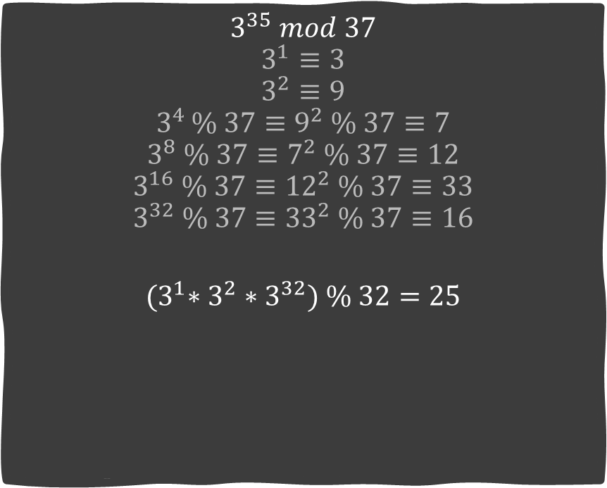
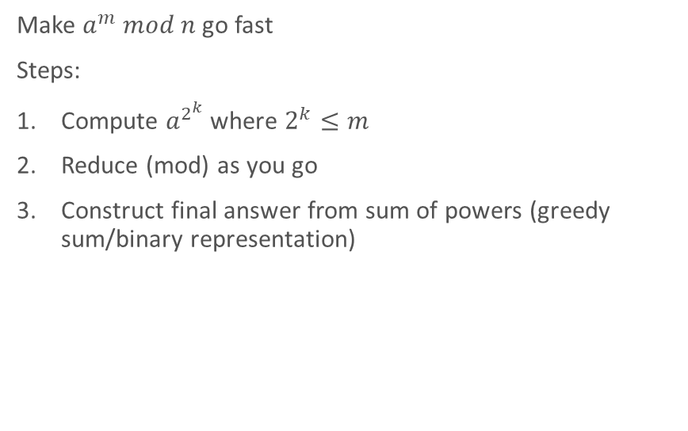
Fast power
$$3^{35} mod 37$$
$$3^{1}≡3$$
$$3^{2}≡9$$
$$3^{4 }\% 37≡9^{2} \% 37≡7$$
$$3^{8} \% 37≡7^{2} \% 37≡12$$
$$3^{16} \% 37≡{12}^{2} \% 37≡33$$
$$3^{32} \% 37≡{33}^{2} \% 37≡16$$
$${(3}^{1}∗3^{2}∗3^{32}) \% 32=25$$
Make $a^{m} mod n$ go fast
Steps:
Compute $a^{2^{k}}$ where $2^{k}≤m$
Reduce (mod) as you go
Construct final answer from sum of powers (greedy sum/binary representation)

Slide 7
Fast power
past_results.push_back(previous_result);
for (int k = 1; k <= floor(log2(m)); k++) {
previous_result = (previous_result*previous_result)%n;
past_results.push_back(previous_result);
}
int ans = 1;
// Iter through each bit of the power
for (int i = sizeof(int)*8-1; i >= 0; i--) {
if (bit_set(m, i)) {
ans = ans*past_results[i] % n;
}
}
return ans;
}
bool bit_set(int n, int k) {
return n & (1 << (k));
}
int fastpower(int a, int m, int n) {
if (m==0) return 1;
vector<int> past_results;
past_results.reserve(floor(log2(m)));
int previous_result = a % n;

Slide 8
Many thank.
Another absolutely✨stunning✨ presentation by Jacques Amsel

